Slide 1
Inequality, mobility and classes

Slide 2
Inequality
Definition of classes
Classes in the past centuries and today
Influences of classes in today’s societies
Definition of castes
Castes in the past and today

Slide 3
1. Definition of classes
Social stratification based on birth and individual achievement
Status hierarchy
Classification on the basis of esteem and prestige
Acquirement through economic success and accumulation of wealth

Slide 4
2. Classes in the past centuries
1. Karl Marx: two great classes
owners of the means of production
workers → “labour power”
2. Industrial society (1960)
Upper class, middle class, working class

Slide 5
2. Classes in today’s societies
America
Upper class
Middle class
Working class
Lower class

Slide 6
2. Classes in the U.S. today
1. Upper Class – Elite (> $200,000)
Upper-upper class (old-rich)
Upper-lower class (new-rich)
2. Middle Class
Upper middle class ($112,500 to $200,000)
Lower middle class (around $60,000)

Slide 7
2. Classes in the U.S. today
3. Working Class ($27,000 to $48,000)
blue-collar workers
4. Lower Class (< $27,000)
wages below the poverty line
→ lack of financial security
Similar class systems in Western Europe and Japan

Slide 8
2. Reasons for classification
Differences in…
Income and wealth
Ancestry
Education system
Authority levels
Housing situations
Race and ethnicity

Slide 9
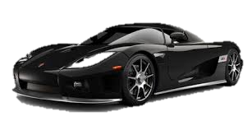
3. Influences of classes in society
Health
Values and Attitudes
Politics
Family and Gender

Slide 10
4. Definition of castes
social stratification based on ascription or birth
Differences to classes:
Closed class system with life time status
No possibility of social mobility
No inter-caste marriage
Based on cultural beliefs and religion

Slide 11
5. Castes in the past and today
UK:
Past: caste like aristocracy
→Leading clergy, nobility, commoners
Today: Class system mixes caste and meritocracy
→More emphasis on labour, money and education

Slide 12
5. Castes in the past and today
Japan
Past: rigid caste system
Imperial family ruled over nobles and commoners
Today: operating monarchy and modern society
→importance of family background and traditional gender rules

Slide 13
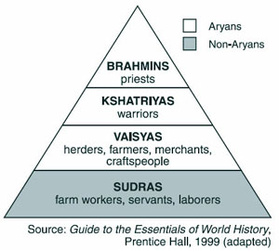
5. Castes in the past and today
Hindu caste system
Formally outlawed
Rural India: traditional
caste system
Cities: class system

Slide 14
Mobility
Horizontal mobility
Vertical mobility
2.1 Intragenerational mobility
2.2 Intergenerational mobility
3. Intergenerational mobility data
3.1 Open society
3.2 Social reproduction theory
3.3 Chosen data

Slide 15
Social mobility
Movement of individuals or groups in social structure
Measures the change in education, income, health status and literacy

Slide 16
1. Two directions of social mobility
Horizontal mobility
Vertical mobility

Slide 17
1. Horizontal mobility
Movement of individuals and groups within the same social class or the same level of hierarchy
Change of workplace without changing a position or change of residence

Slide 18
2. Vertical mobility
Going down (degradation) or up (social promotion) in the class structure or in the social hierarchy
Changes in the structure of society and re-evaluating the scale of social stratification
Higher vertical mobility is an indicator of the openness of the society

Slide 19
2.1 Intragenerational mobility
Movement of individuals between levels of the hierarchy
Degradation → other individuals or groups through their own social promotion raise the level in the hierarchy

Slide 20
2.2 Intergenerational mobility
Mobility of social categories from the position occupied by their parents
Measure → intergenerational elasticity
The higher the intergenerational elasticity, the less social mobility a society offers

Slide 21
3. Intergenerational mobility data
Open society
versus
Social reproduction theory

Slide 22
3.1 Open society
Career advancement and social development are approved and expected
Non-ascribed positions = positions of members of this society are not assigned at birth

Slide 23
3.2 Social reproduction theory
Social inequality is transmitted from one generation to the next
Four kinds of capital:
Financial capital
Cultural capital
Human capital
Social capital
Intergenerational mobility doesn´t exist

Slide 24
3.3 Chosen data
United Kingdom
Studies on social mobility made by government
“you can reach the stars of career” no matter where you come from??

Slide 25
Graduation

Slide 26
Jobs
24% of vice-chancellors
32% of members of Parliament
51% of top medics
54% of London Stock Exchange workers
54% of top journalists
70% of High Court judges
went to private school, though only 7% of the population do

Slide 27
Qualifications of mothers

Slide 28
Aspirations

Slide 29
Achievement

Slide 30
Curiosity

Slide 31
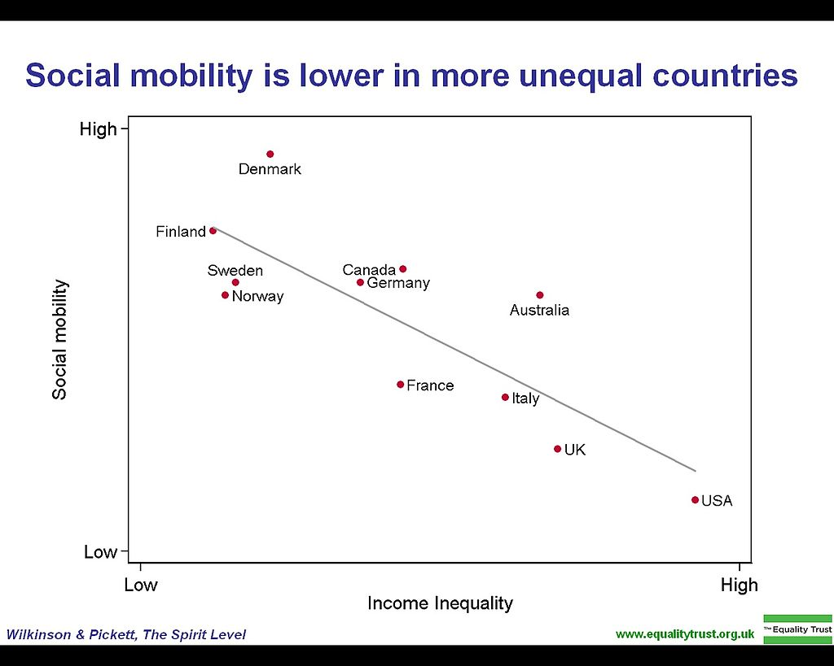
Social mobility: US vs. Scandinavia

